Slide 1
Disease Prediction using Medical Imaging and Machine Learning
Dr. Munesh Chandra
NIT, Agartala

Slide 2
OUTLINE
Data Science & Healthcare
Data science and Machine learning in Healthcare
How machine Learning can help with Diagnostics
Classification Of Glioma Grades Into High Grade & Low-grade In MR Images Using Machine Learning
What is unique about ML in healthcare?
Key challenges for healthcare data
Conclusion

Slide 3
Data Science & Healthcare
Health care is a wide term that concerns to a system that involves improvement of medical services in order to serve the medical demands of the people. In healthcare, efforts are made by patients, physicians, vendors, health companies and IT companies for maintaining and restoring health records.
Healthcare includes data in various types such as clinical data, Omics data, and Sensor data.
Clinical data includes electronic health records which store patient records collected during ongoing treatment.
Omics data is one of the high dimensional data comprising genome, transcriptome and proteome data types.
Sensor data is collected from various wearable and wireless sensor devices.
To handle this raw data manually is very difficult.
This is where Data Science provides a sea of opportunities for the healthcare industries to collect, organize, and analyze these data in the most efficient ways possible.

Slide 4
Data Science & Healthcare
Data science is an interdisciplinary field that extracts knowledge and insights from many structural and unstructured data, using scientific methods, data mining techniques, machine-learning algorithms, and big data.
Data science in health care has seen the latest and most rapid progress in 3 ways:
Using big data with a combination of large and complex data sets includes electronic medical records, social media, genomic information, and digital body data from wireless health devices.
With new open-access efforts that seek to utilize the availability of clinical trials, research, and citizen science sources for data sharing.
In the analysis techniques, especially of big data, including machine learning and artificial intelligence that can improve systematic and unstructured data analysis.

Slide 5
Data Science Use Cases in Healthcare
Data Science for Medical Image Analysis
Providing Virtual Assistance for Patients and Customer Support
Genetics and Genomics
Data Management and Data Governance
Predictive Analysis and Disease Prevention

Slide 6
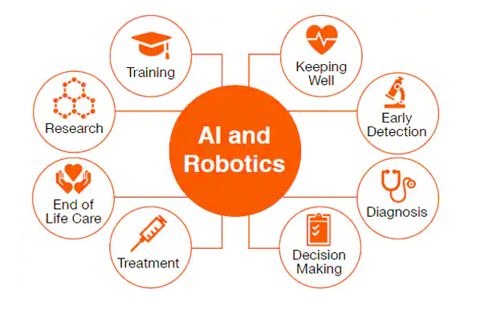
Data science and Machine learning in Healthcare
Healthcare sector is being transformed by the ability to record massive amounts of information
Machine learning provides a way to automatically find patterns and reason about data
It enables healthcare professionals to move to personalized care known as precision medicine.
Analysis of big data by machine learning offers considerable advantages for assimilation and evaluation of large amounts of complex health-care data.

Slide 7
How machine Learning can help with Diagnostics
Recently, hospitals have started using machine learning to speed up the process of diagnosis and analysis. Now, doctors can get support in diagnosis to reach the treatment phase as quickly as possible.
With machine learning being used to analyze the diagnosis reports or CT scans, finding anomalies or even malign cells can be done with a super-human level of perfection.
With a huge amount of data in hand, data scientists can use machine learning to find correlation between various attributes and features of the patients with the labeled disease. These correlations can help doctors understand the underlying patterns of disease, and come up with prevention plans.
Once the machine learning model extracts information, doctors can recommend a proper medical routine that not only reduces the financial expenses of the patient but also reduces the chances of developing something more drastic like a tumor.
Not treating a symptom or a pain in the early stages can be very risky not only to the patient’s health but also considering the economic costs. As the disease grows, the cost of treating it also increases. In this sense, data science can play a huge role in optimizing healthcare spending

Slide 8
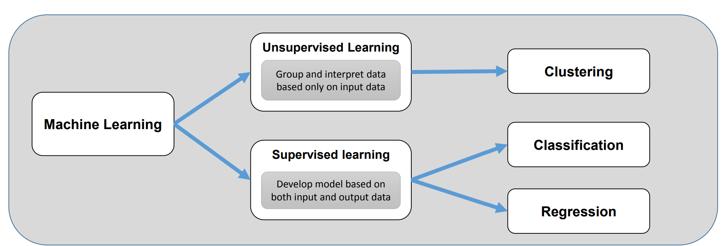
How Machine Learning Works
Machine learning is a field of computer science that uses statistical techniques to give computer systems the ability to “learn” with data, without being explicitly programmed.
Machine learning algorithms use computation methods to “learn” information directly from data without relying on a predetermined equation to model. The algorithms adaptively improve their performance as the number of data samples available for learning increases.
➢ Supervised learning, which trains a model on known inputs and output data to predict future outputs
➢ Unsupervised learning, which finds hidden patterns or intrinsic structures in the input data
➢ Semi-supervised learning, which uses a mixture of both techniques; some learning uses supervised data, some learning uses unsupervised learning

Slide 9
Deep Learning
The most complex forms of machine learning involve deep learning, or neural network models with many levels of features or variables that predict outcomes.
There may be thousands of hidden features in such models, which are uncovered by the faster processing of today's graphics processing units and cloud architectures.
A common application of deep learning in healthcare is recognition of potentially cancerous lesions in radiology images.
Deep learning is increasingly being applied to radiomics, or the detection of clinically relevant features in imaging data beyond what can be perceived by the human eye.
Both radiomics and deep learning are most commonly found in oncology-oriented image analysis. Their combination appears to promise greater accuracy in diagnosis than the previous generation of automated tools for image analysis, known as computer-aided detection or CAD.

Slide 10
What is unique about ML in healthcare?
Life or death decisions
• Need robust algorithms
• Checks and balances built into ML deployment
• Also arises in other applications of AI such as autonomous driving) • Need fair and accountable algorithms
• Many questions are about unsupervised learning
• Discovering disease subtypes, or answering question such as “characterize the types of people that are highly likely to be readmitted to the hospital”?
• Many of the questions we want to answer are causal
• Naïve use of supervised machine learning is insufficient

Slide 11
CLASSIFICATION OF GLIOMA GRADES
INTO HIGH GRADE & LOW-GRADE IN MR IMAGES
USING MACHINE LEARNING

Slide 12
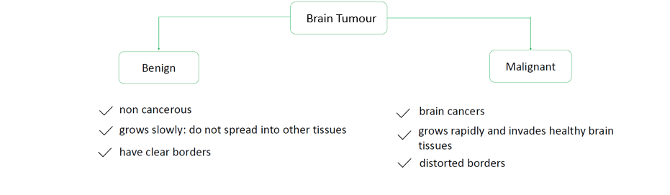
Brain Tumor /Glioma
In the field of Medical Image Analysis, research on Brain tumors is one of the most prominent ones.
Primary brain tumors occur in around 250,000 people a year globally, making up less than 2% of cancers.
Problem is Brain Tumours vary in size ,shape , appearances ,colour ,location and orientation ,which is precisely the reason why tumour segmentation is challenging.
The major drawback of manual detection is that it is time consuming and prone to human error.
A Brain Tumour is a mass of cells that have grown and multiplied uncontrollable.
Glioma is the most common malignant brain tumor.

Slide 13
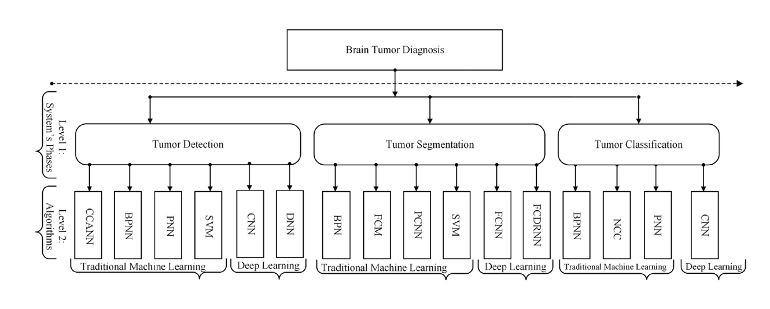
Levels of Tumor Diagnosis

Slide 14
Key differences between machine learning and deep learning
 | Machine Learning | Deep Learning
Definition | Subfield of AI that focuses on machines being able to learn without being explicitly programmed. | Subfield of ML that focuses on machines being able to mimic the human brain to perform highly complex AI problems.
Data Feeding | We give structured data to the machine that builds the ML model. | We give unstructured data or you can say the raw input to the neural network.
Volume of Data | ML models deal with datasets having thousands of data rows. | Deep learning models mostly deal with datasets having millions of data rows.
Training Time | ML models take less time in training because of the small data size. | It takes a huge amount of time because of massive data points.
Human Involvement | Machine learning models are easy to build but require more human interaction to make better predictions. | Deep learning models are difficult to build as they use complex multilayered neural networks but they have the capability to learn by themselves.
Feature Engineering | Feature engineering is done explicitly by humans. | No need of feature engineering, neural networks automatically detect important features.
Goal | To give the output as close as it can be to the expected output. | To mimic the human brain processing, how they actually think. If somehow machines are able to think that way they will automatically generate the right output.
Interpreting Results | It is easy to explain the results of an ML model. | It is difficult to explain the results of a deep learning model since it’s hard to interpret the output of a complex multi-layered neural network.

Slide 15
Support Vector Machine or SVM
Advantages:
SVM works relatively well when there is a clear margin of separation between classes.
SVM is more effective in high-dimensional spaces.
SVM is effective in cases where the number of dimensions is greater than the number of samples.
SVM is relatively memory efficient
Disadvantages:
SVM algorithm is not suitable for large data sets.
SVM does not perform very well when the data set has more noise i.e. target classes are overlapping.
In cases where the number of features for each data point exceeds the number of training data samples, the SVM will underperform.
As the support vector classifier works by putting data points, above and below the classifying hyperplane there is no probabilistic explanation for the classification.

Slide 16
Convolutional Neural Network (CNN)
Convolutional neural networks (CNN) are one of the most popular models used today. This neural network computational model uses a variation of multilayer perceptrons and contains one or more convolutional layers that can be either entirely connected or pooled. These convolutional layers create feature maps that record a region of image which is ultimately broken into rectangles and sent out for nonlinear processing.
Advantages:
Very High accuracy in image recognition problems.
Automatically detects the important features without any human supervision.
Weight sharing.
Disadvantages:
CNN do not encode the position and orientation of object.
Lack of ability to be spatially invariant to the input data.
Lots of training data is required.

Slide 17
A flowchart of a generic computer-aided diagnosis (CAD) system for diagnosing brain tumors
This flowchart shows all stages of a complete CAD system; it is necessary to have all the stages combined in one system. The tumor detection stage does not appear because the CAD system assumes that the tumor is present in the collected data.

Slide 18
Tumor Grading
A tumor grade is a way to classify a tumor and will help members of the healthcare team communicate more clearly about the tumor, determine treatment options, and predict outcomes.
Tumors are assigned Grade I, II, III, or IV based on abnormalities of the cells they contain. A tumor can have more than one grade of cell. The highest, or most malignant, grade of cell determines the tumor’s grade, even if most of the tumor is made up of lower-grade cells.
Brain Tumor
Benign
Malignant
Primary
Secondary
Meningioma
Gliomas
Pituitary
Grade 1
Grade 2
Grade 3
Grade 4
LOW GRADE GLIOMA(LGG)
HIGH GRADE GLIOMA(HGG)

Slide 19
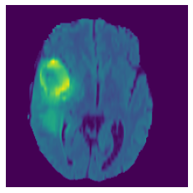
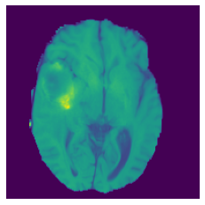
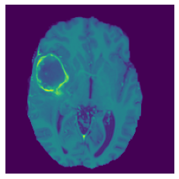
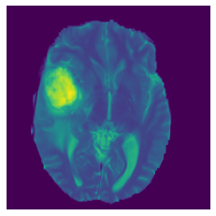
Characterizing Gliomas
MRI is first utilized clinically when, after a general medical examination, there is a suspicion of the presence of a brain tumor. Once confirmed its existence, conventional and advanced MRI can be used to delimit the tumor, to follow its evolution, as well as to obtain some evidence about its type and malignancy grade.
Radiology-
With its superior image contrast and capacity to quantify physiologic parameters MR imaging is majorly preferred radiology for clinical tumour imaging.
MRI helps portray the phenotype and intrinsic heterogeneity of gliomas. Multimodal MRI scans, such as T1-weighted, contrast enhanced T1-weighted (T1Gd), T2-weighted, and Fluid Attenuation Inversion Recovery (FLAIR) images, provide complementary profiles for different sub-regions of gliomas.
Flair T1 T1c T2

Slide 20
Public MRI Datasets
# | Database | Location
1 | BRAINIX medical images | https://www.medicalimages.com/search/brain.html
2 | TCGA-GBM, TCGA-LGG | https://wiki.cancerimagingarchive.net/display/Public/TCGA-LGG
3 | Figshare (Cheng) | https://figshare.com/articles/brain_tumor_dataset/1512427
4 | Harvard Medical School | http://med.harvard.edu/AANLIB/
5 | Moffitt Cancer Research Center | https://moffitt.org/
6 | BraTS 2013, 2014, 2016, 2018, 2020 | https://ipp.cbica.upenn.edu/

Slide 21
Challenges
Difficulties of brain tumor segmentation
The size, shape and location of glioma is unpredictable
Difficulties of getting prognosis information
Molecular information is shown to be expressed in MR images, molecular information is shown to be expressed in imaging, however the information is difficult to be determined and described
Computational Cost
Although the most complex models tend to be the most flexible, the computational cost is also higher

Slide 22
Significance of Study
In patients with gliomas, assessment of tumor grade and type is essential, since the malignancy grade directly reflects the clinical course and prognosis.
Currently, the standard diagnosis of gliomas is performed by histopathological tests after performing a surgical resection or a stereotactic biopsy (which can be guided by MRI).These procedures are invasive and can be risky due to the location of the tumor.
Moreover, the histopathological features are not always easy to be recognized, and physicians may have different views about them, thus some misdiagnosis can still happen due to glioma heterogeneity or subjective judgments by physicians.
An efficient, automated method for brain tumour classification aids clinicians in the interpretation of medical pictures and supports experts decisions in the early phases of tumour growth.
In addition, accurate information on tumor grade enables treatment optimization, including surgery, chemotherapy, and radiation.

Slide 23
Motivation & Objective
MOTIVATION
Well adaptation of automated medical image analysis.
Early detection of Brain Tumors for reducing death rates.
Reducing the pressure on Human judgment.
Build a User Interface which can identify the cancerous cells.
OBJECTIVE
The primary goal of medical imaging is to extract meaningful and accurate information from the image scans with least possible error.
The system that incorporates image processing, pattern analysis, and computer vision techniques and is expected to improve the sensitivity, specificity, and efficiency of brain tumor screening.
The main goal of this research work is to design efficient automatic brain tumor classification model which distinguishes low grade gliomas (LGGs) from high grade gliomas (HGGs), applied to conventional brain MRI with high accuracy, performance and low complexity.

Slide 24
Implementation Flow
INPUT
Stage- I
Stage- II
Stage- III
OUTPUT
LOW GRADE GLIOMAS
MRI
DATASET
PRE-PROCESSING
SEGMENTATION
CLASSIFICATION
HIGH GRADE GLIOMAS

Slide 25
Block diagram of the Proposed Methodology
Training LGG/HGG Dataset
Pre-processing
Segmentation
Training using
ML/DL Algo
Training Model
Output
LGG/HGG
Test MRI
Pre-processing
Segmentation

Slide 26
The State of the Art in Brain Cancer Classification
Author & Year | Classification Tasks | Model Architecture | Validation | Performance | ACC%
Özcan et al. [1] 2021 | LGG (grade II) vs. HGG (grade IV) | Custom CNN model | 5-fold CV | SEN = 98.0%, SPE = 96.3%, F1 score = 97.0%, AUC = 0.989 | 97.1
Hao et al. [2] 2021 | LGG vs. HGG | Transfer learning with AlexNet | No info shared | AUC = 82.89%
Tripathi et al. [3] 2021 | LGG vs. HGG | Transfer learning with Resnet18 | No info shared |  | 95.87
Ge et al. [4] 2020 | LGG vs. HGG | Custom CNN model | No info shared | SEN = 84.35%, SPE = 93.65% | 90.7
Mzoughi et al. [5] 2020 | LGG vs. HGG | Multi-scale 3D CNN | No info shared |  | 96.49
Yang et al. [6] 2018 | LGG vs. HGG | Transfer learning with AlexNet, GoogLeNet | 5-fold CV | AUC = 0.939 | 86.7
Zhuge et al. [7] 2020 | LGG vs. HGG | Transfer learning with ResNet50 | 5-fold CV | SEN = 93.5%, SPE = 97.2% | 96.3
 |  | 3D CNN | 5-fold CV | SEN = 94.7%, SPE = 96.8% | 97.1
Decuyper et al. [8] 2021 | LGG vs. GBM | 3D CNN | No info shared | SEN = 90.16%, SPE = 89.80%, AUC = 0.9398 | 90
He et al. [9] 2021 | LGG vs. HGG | Custom CNN model | 5-fold CV | TCIA: SEN = 97.14%, SPE = 90.48%, AUC =0.9349 BraTS 2017: SEN = 95.24%, SPE = 92%, AUC =0.952 | 92.86 94.39

Slide 27
The State of the Art in Brain Cancer Classification
Author & Year | Classification Tasks | Model Architecture | Validation | Performance | ACC%
Hamdaoui et al. [10] 2021 | LGG vs. HGG | Transfer learning with stacking VGG16, VGG19, MobileNet, InceptionV3, Xception, Inception ResNetV2, DenseNet121 | 10-fold CV | PRE = 98.67%, F1 score = 98.62%, SEN =98.33% | 98.06
Chikhalikar et al. [11] 2021 | LGG vs. HGG | Custom CNN model | No info shared |  | 99.46
Ahmad [12] 2019 | LGG vs. HGG | Custom CNN model | No info shared |  | 88
Naser et al. [13] 2020 | LGG (Grade II) vs. LGG (Grade III) | Transfer learning with VGG16 | 5-fold CV | SEN = 97%, SPE = 98% | 95
Tandel et al. [14]2021 | 1. Normal vs. Tumorous | DL-MajVot (AlexNet, VGG16, ResNet18, GoogleNet, ResNet50) | 5-fold CV | SEN = 96.76%, SPE = 96.43%, AUC = 0.966 | 96.51
 | 2. AST-II vs. AST-III | DL-MajVot (AlexNet, VGG16, ResNet18, GoogleNet, ResNet50) | 5-fold CV | SEN = 94.63%, SPE = 99.44%, AUC = 0.9704 | 97.7
 | 3. OLI-II vs. OLI-III | DL-MajVot (AlexNet, VGG16, ResNet18, GoogleNet, ResNet50) | 5-fold CV | SEN = 100%, SPE = 100%, AUC = 1 | 100
 | 4. LGG vs. HGG | DL-MajVot (AlexNet, VGG16, ResNet18, GoogleNet, ResNet50) | 5-fold CV | SEN = 98.33%, SPE = 98.57%, AUC = 0.9845 | 98.43

Slide 28
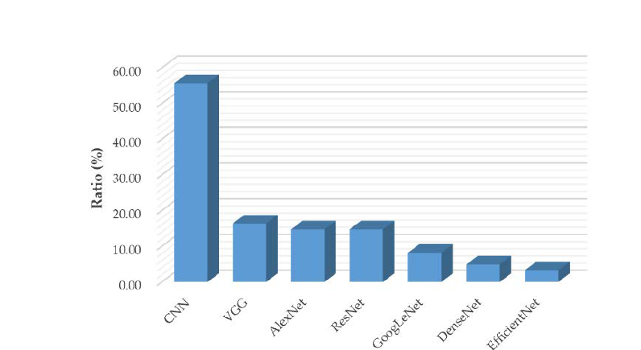
Usage of state-of-the-art CNN models from 2015 and 2021.
Fig. Usage of state-of-the-art CNN models from 2015 and 2021.

Slide 29
Use of Multiparametric Magnetic resonance imaging in Staging Prostate Cancer

Slide 30
Introduction
Prostate Cancer is a primary cause of cancer mortality in men. It is one of the top ten types of cancer that kill men the most often.
Multiparametric Magnetic Resonance Image(mpMRI) has become more popular in prostate cancer imaging over the last decade. The applications of mpMRI can be listed as:
1-Identify the Prostate Cancer
2-Delineation of Prostate Cancer
3-Stratification of menace.
4-Staging and grading of Prostate Cancer
5-Guide biopsy and prompt assessment

Slide 31
mpMRI and MRI
The most common MRI sequences are T1-weighted and T2-weighted scans.
Multiparametric Magnetic Resonance Image (mpMRI) should include
T1 - weighted (T1W),
T2 - weighted (T2W),
Diffusion-weighted image (DWI), and
dynamic contrast-enhanced (DCE) sequences.
the existing imaging modalities of multiparametric magnetic resonance are the best at detecting prostate cancers.

Slide 32
Lesion Grading in Prostate cancer
Category 1 – Cancer is quite unlikely (Very low)
Category 2 – Significant cancer is improbable (Low)
Category 3 – Cancer is clinically significant (Intermediate)
Category 4 –Significant cancer is likely (High)
Category 5 – Cancer is likely clinically significant (Very high)

Slide 33
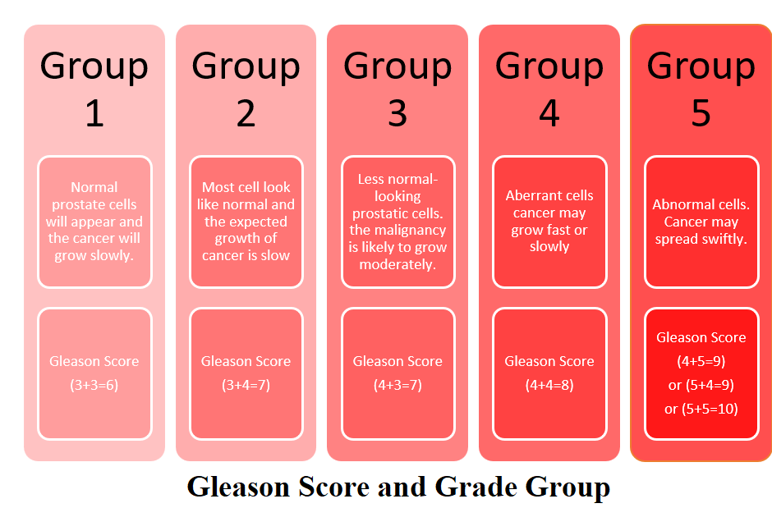
Gleason score and Group
The Gleason score is a way to tell what will happen with prostate cancer. It shows how aggressiveness of the tumor.

Slide 34
Machine Learning pipeline
Machine learning pipelines for prostate MRI A typical ML post-processing pipeline applied to prostate MRI for radiomic analysis may be constituted by:
1. mpMRI examination: T2-weighted sequences, diffusion-weighted imaging (DWI) with apparent diffusion coefficient (ADC) maps, and dynamic contrast-enhanced (DCE) sequences
2. Image segmentation through the delineation of regions of interest (ROIs), which can include whole gland volume, a specific zone, or one or multiple lesions (e.g., deep convolution Neural network (DCNN) ), k-means clustering algorithm, etc.
3. Image pre-processing: voxel grey value normalisation (when using non-quantitative images, i.e., T2- weighted, DWI, or DCE sequences), decomposition filtering for the creation of additional mineable data (e.g., Laplacian of Gaussian)

Slide 35
Continue…
4. Feature extraction from the ROI: shape, histogram, and texture (second-order features) parameters
5. Integration of radiomic data with clinical, laboratory, prognostic, and/or genomic data
6. Feature selection in relation to the class of interest
7. Algorithm training and testing
8. Validation on an external population

Slide 36
Deep Learning Approach
A deep learning approach would only require:
1. mpMRI examination: T2-weighted sequences, DWI with ADC maps, and DCE sequences
2. Annotation of the ROI or of the whole image, according to the desired classification output (Labelling and tagging of data)
3. Algorithm training and testing (CNN, ResNet, Unet, etc.)
4. Validation on an external population

Slide 37
Methods
The classification of lesions is a broad domain due to the most variate scores scales given to the lesions.
A binary classification problem based on the prediction of the clinical significance of the lesions.
Complex problem aiming to predict the Prostate Imaging-Reporting and Data System (PI-RADS) score, thus a multi-class classification problem

Slide 38
Lesion classification
Prostate cancer lesions vary in shape, size, and intensity, even their aggressiveness changes accordingly.
Being able to define and categorize the aggressiveness of a lesion is one of the roles of experts when dealing with multi-parametric magnetic resonance images of the prostate.
The first step to attain the desired data format was to spatially locate the lesions in the 3D space. To efficiently locate the lesions, their domain area was approximated, and the initial and final points were marked independently in every slice.

Slide 39
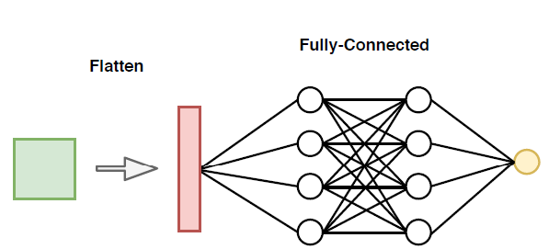
Clinical significance classification
Layers are responsible for using the extracted features from the convolutional part and computing from them the prediction, and are specific for the binary classification problem.

Slide 40
Data augmentations
Neither the prostate cancer lesion segmentation problem nor the prostate segmentation problem had abundant data and examples to learn from. As seen before, machine learning and especially deep learning algorithms rely considerably on the number of samples in the training set that represent potentially different situations and variability between samples.
Variation in the data and a considerable number of distinct samples is a mechanism to avoid also overfitting and improve the generalization capabilities of the model at hand.

Slide 41
Research Trends
Along with the blooming of Artificial Intelligence (AI) and the accompanying increase in model complexity, there has been a surge of interest in explainable AI (XAI henceforth), namely AI that allows humans to understand its inner workings.
XAI has already shown to improve clinicians’ ability to diagnose and assess prognoses of diseases as well as assist with planning and resource allocation.

Slide 42
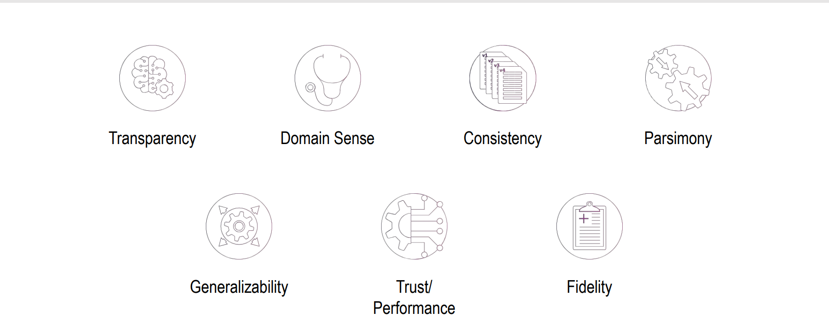
7 Pillars of Explainable AI in HealthCare

Slide 43
Pillar 1: Transparency
Transparency
Ability of the machine learning algorithm, model and the feature to be understandable by the user of the system.
Transparency may mean different, different things to different people.
Example- understanding output.

Slide 44
Pillar 2: Domain Sense
Domain Sense
The explanation should make sense in the domain of application and to the user of the system.
1- Making Sense of Model Output
2-Actionability

Slide 45
Pillar 3: Consistency
Consistency
XAI can simply be described as aiming to make AI systems more understandable to humans; however, there is no accepted technical definition of XAI at this time, and more clarity and consistency is required in terms of the terminology in use.
The explainable should be consistent across different models and across different runs of the model.
The explainable from multiple explainable algorithms should be very similar.

Slide 46
Pillar 4: Parsimony
Parsimony
The explanation should be as simple as possible.
Applies to both the complexity of the explanation and the number of features provided to explain.
The simplest explanation is not always the best explanation.

Slide 47
Pillar 5: Generalizability
Generalizability
Models and explanations should be generalizable across problem whenever possible.
Models generalizability
Local Model- Models that give an explanation at the level of an instance.
Global Model-Models that give explanations.

Slide 48
Pillar 6: Trust/Performance
Trust/Performance
The expectation that the corresponding predictive algorithm for explanations should have a certain performance.
Expectation that the predictive systems have a sufficiently high performance e.g. Precision, recall, AUC, etc.

Slide 49
Pillar 7: Fidelity
Fidelity
Also known as Shadow, Surrogate
The expectation that the explanation and the predictive model align well with one another.
An explanation is complete if it encompasses the complete extent of the model.
Ante-Hoc: Models where the predictive and explanation models are the same.
Post-Hoc Models: Models where the predictive model and the explanation model are different.

Slide 50
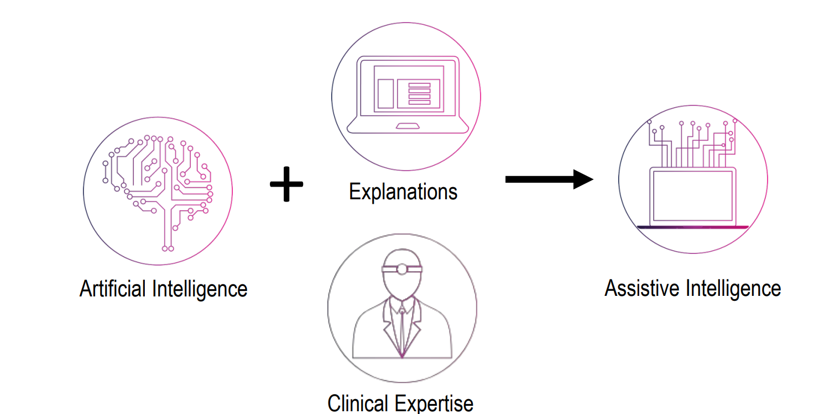
Explainable ML in Healthcare AI

Slide 51
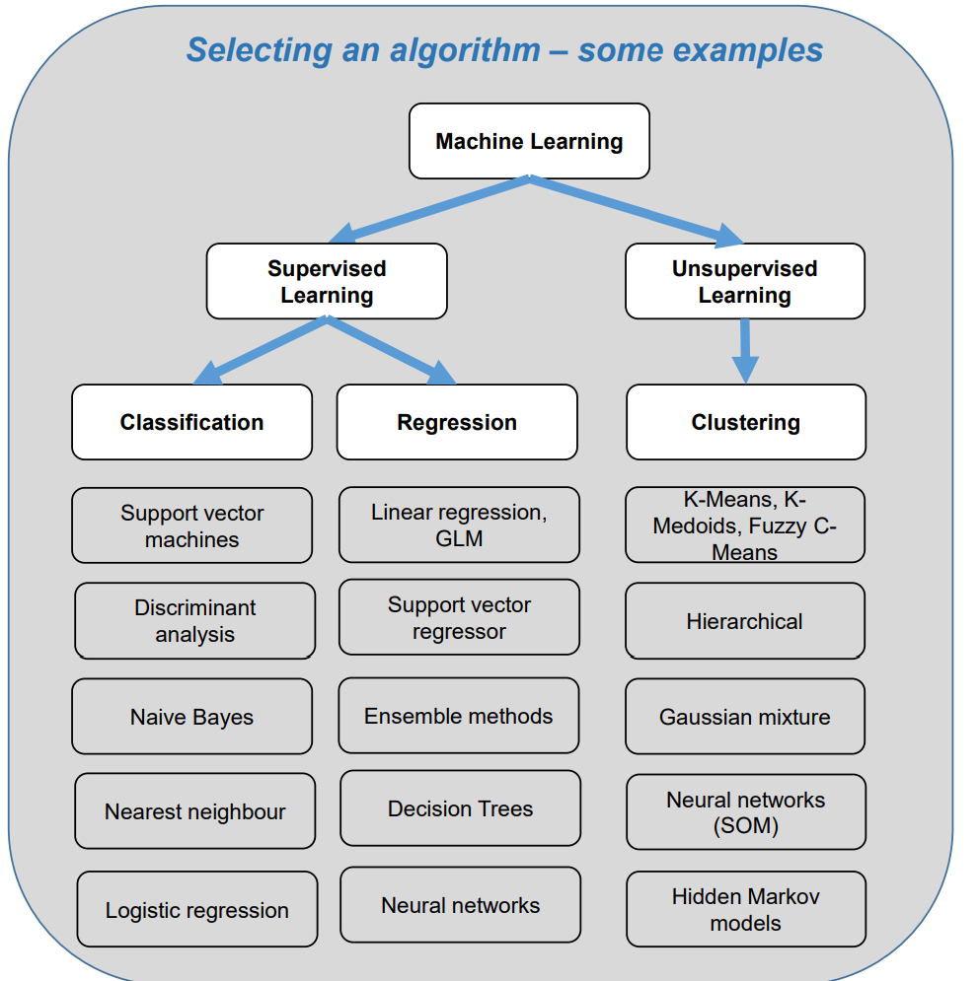
How do you decide which algorithm to use?
Choosing the right algorithm can seem overwhelming – there are about a dozen supervised and unsupervised learning algorithms, each taking a different approach.
Considerations:
There is no best method or one size fits all
Trial and error
Size and type of data
The research question and purpose
How will the outputs be used?

Slide 52
Key challenges for healthcare data
Most challenges come from handling your data and finding the “right” model
Data comes in all shapes and sizes: Real-world datasets are messy, incomplete, and come in a variety of formats
Pre-processing your data requires clinical knowledge and the right tools: For example to select the correct features (variables) and codes to use in primary care datasets, you’ll need clinical verification and knowledge of NHS coding and content expertise
Can your question be answered without ML: many research questions don’t actually require ML. For instance, accurate risk prediction models can be developed stepwise regression models.
Choosing the “right” model: Highly flexible models tend to over-fit while simple models make too many assumptions. Trial and error is at the core of machine learning ➢ Understand the limitations: Not recommended for causal inferences, interpretation of results can be difficult

Slide 53
What makes healthcare different?
• Often very little labeled data (e.g., for clinical NLP)
• Motivates semi-supervised learning algorithms
• Sometimes small numbers of samples (e.g., a rare disease)
• Learn as much as possible from other data (e.g. healthy patients)
• Model the problem carefully
• Lots of missing data, varying time intervals, censored labels
Difficulty of de-identifying data
• Need for data sharing agreements and sensitivity
• Difficulty of deploying ML
• Commercial electronic health record software is difficult to modify
• Data is often in silos; everyone recognizes need for interoperability, but slow progress
• Careful testing and iteration is needed

Slide 54
Conclusion
Larger patient datasets can be obtained from medical care organizations that include data from surveillance, laboratory, genomics, imaging, and electronic healthcare records. This data requires proper management and analysis to derive meaningful information. Long-term visions for self-management, improved patient care, and treatment can be realized by utilizing big data.
Data Science can bring in instant predictive analytics that can be used to obtain insights into a variety of disease processes and deliver patient-centric treatment. It will help to improvise the ability of researchers in the field of science, epidemiological studies, personalized medicine, etc.
Modern health organizations can revolutionize medical therapy and personalized medicine by integrating biomedical and health data. Data science can effectively handle, evaluate, and interpret big data by creating new paths in comprehensive medical care.
AI & ML offers several advantages over traditional analysis and clinical decision-making techniques. Learning algorithms can become more precise and accurate as they interact with training data, providing humans with unprecedented insights into diagnostics, care processes, treatments, manufacturing processes, and patient outcomes.
The greatest challenge to AI/ML in these healthcare domains is ensuring their adoption in daily clinical practice. For widespread adoption to take place, AI systems must be approved by regulators, standardised to a sufficient degree that similar products work in a similar fashion, taught to clinicians, paid for by public or private payer organisations and updated over time in the field.
These challenges will ultimately be overcome, but they will take much longer to do so than it will take for the technologies themselves to mature. As a result, we expect to see limited use of ML/DL in clinical practice within 5 years and more extensive use within 10.

Slide 55
References
Özcan H; Emiroğlu B G; Sabuncuoğlu H; et al. A comparative study for glioma classification using deep convolutional neural networks. [J]. Mathematical Biosciences and Engineering: MBE 2021, 18, 1550-1572
Hao R; Namdar K; Liu L; et al. A transfer learning–based active learning framework for brain tumor classification[J]. Frontiers in Artificial Intelligence 2021, 4.
Tripathi P C; Bag S. A computer-aided grading of glioma tumor using deep residual networks fusion[J]. Computer Methods and Programs in Biomedicine 2022, 215, 106597.
Ge, C.; Gu, I. Y. H.; Jakola, A. S.; Yang, J. Deep semi-supervised learning for brain tumor classification. BMC Medical Imaging2020, 20, 1-11.
Mzoughi H; Njeh I; Wali A; et al. Deep multi-scale 3D convolutional neural network (CNN) for MRI gliomas brain tumor classification[J]. Journal of Digital Imaging 2020, 33, 903-915.
Yang Y; Yan L F; Zhang X; et al. Glioma grading on conventional MR images: a deep learning study with transfer learning[J].Frontiers in neuroscience 2018, 804.
Zhuge Y; Ning H; Mathen P; et al. Automated glioma grading on conventional MRI images using deep convolutional neural networks[J]. Medical physics 2020, 47, 3044-3053.
Decuyper M; Bonte S; Deblaere K; et al. Automated MRI based pipeline for segmentation and prediction of grade, IDH mutationand 1p19q co-deletion in glioma[J]. Computerized Medical Imaging and Graphics 2021, 88, 101831
He M; Han K; Zhang Y; et al. Hierarchical-order multimodal interaction fusion network for grading gliomas[J]. Physics in Medicine & Biology 2021, 66, 215016.
El Hamdaoui H.; Benfares, A.; Boujraf, S.; et al. High precision brain tumor classification model based on deep transfer learning and stacking concepts. Indonesian Journal of Electrical Engineering and Computer Science 2021, 24, 167-177.
Chikhalikar A M; Dharwadkar N V. Model for Enhancement and Segmentation of Magnetic Resonance Images for Brain Tumor Classification[J]. Pattern Recognition and Image Analysis 2021, 31, 49-59.
Ahmad, F. Classification on magnetic resonance imaging (Mri) brain tumour using BPNN, SVM and CNN[J]. International Journal of Recent Technology and Engineering (IJRTE) 2019, 8, 8601-8607.
Naser M A; Deen M J. Brain tumor segmentation and grading of lower-grade glioma using deep learning in MRI images[J]. Computers in biology and medicine 2020, 121, 103758
Tandel G S; Tiwari A; Kakde O G. Performance optimisation of deep learning models using majority voting algorithm for brain tumour classification[J]. Computers in Biology and Medicine 2021, 135, 104564

